Slide 1
Uninformed Search
CSI 2003: Adv Algo
Module 7: Algo for AI
Some material adopted from notes and slides by Marie desJardins and Charles R. Dyer

Slide 2
Building goal-based agents
To build a goal-based agent we need to answer the following questions:
  What is the goal to be achieved?
  What are the actions?
  What is the representation?
    E.g., what relevant information is necessary to encode in order to describe the state of the world, describe the available transitions, and solve the problem?)
Initial
state
Actions
Goal
state

Slide 3
What is the goal to be achieved?
Could describe a situation we want to achieve, a set of properties that we want to hold, etc.
Requires defining a “goal test” so that we know what it means to have achieved/satisfied our goal.
This is a hard question that is rarely tackled in AI, usually assuming that the system designer or user will specify the goal to be achieved.
Certainly psychologists and motivational speakers always stress the importance of people establishing clear goals for themselves as the first step towards solving a problem.

Slide 4
What are the actions?
Characterize the primitive actions or events that are available for making changes in the world in order to achieve a goal.
Deterministic world: no uncertainty in an action’s effects. Given an action (a.k.a. operator or move) and a description of the current world state, the action completely specifies
  whether that action can be applied to the current world (i.e., is it applicable and legal), and
  what the exact state of the world will be after the action is performed in the current world (i.e., no need for “history” information to compute what the new world looks like).

Slide 5
What are the actions? (cont’d)
Note also that actions in this framework can all be considered as discrete events that occur at an instant of time.
  For example, if “Mary is in class” and then performs the action “go home,” then in the next situation she is “at home.” There is no representation of a point in time where she is neither in class nor at home (i.e., in the state of “going home”).
The actions are largely problem-specific and determined (intelligently ;-) ) by the system designer.
There usually are multiple action sets for solving the same problem.
Let’s look an example…

Slide 6
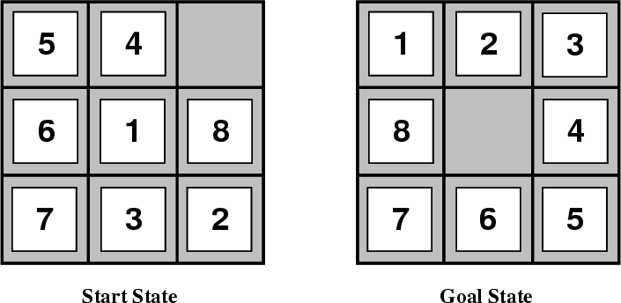
8-Puzzle
Given an initial configuration of 8 numbered tiles on a 3 x 3 board, move the tiles in such a way so as to produce a desired goal configuration of the tiles.

Slide 7
Representing actions
The number of actions / operators depends on the representation used in describing a state.
  In the 8-puzzle, we could specify max. 4 possible moves for each of the 8 tiles, resulting in a total of 4*8=32 operators.
  On the other hand, we could specify four moves for the “blank” square and we would only need 4 operators.
Representational shift can greatly simplify a problem!

Slide 8
Representing states
What information is necessary to encode about the world to sufficiently describe all relevant aspects to solving the goal? That is, what knowledge needs to be represented in a state description to adequately describe the current state or situation of the world?
The size of a problem is usually described in terms of the number of states that are possible.
  The 8-puzzle has 181,440 states.
  Tic-Tac-Toe has about 3⁹ states.
  Rubik’s Cube has about 10¹⁹ states.
  Checkers has about 10⁴⁰ states.
  Chess has about 10¹²⁰ states in a typical game.

Slide 9
Closed World Assumption
We will generally use the Closed World Assumption.
All necessary information about a problem domain is available in each percept so that each state is a complete description of the world.
There is no incomplete information at any point in time.

Slide 10
Some example problems
Toy problems and micro-worlds
  8-Puzzle
  Missionaries and Cannibals
  Cryptarithmetic
  Remove 5 Sticks
  Water Jug Problem
Real-world problems

Slide 11
8-Puzzle
Given an initial configuration of 8 numbered tiles on a 3 x 3 board, move the tiles in such a way so as to produce a desired goal configuration of the tiles.

Slide 12
8-Puzzle
State Representation: 3 x 3 array configuration of the tiles on the board.
Operators: Move Blank Square Left, Right, Up or Down.
  This is a more efficient encoding of the operators than one in which each of four possible moves for each of the 8 distinct tiles is used.
Initial State: A particular configuration of the board.
Goal: A particular configuration of the board.
State Representation: 3 x 3 array configuration of the tiles on the board.
Operators: Move Blank Square Left, Right, Up or Down.
  This is a more efficient encoding of the operators than one in which each of four possible moves for each of the 8 distinct tiles is used.
Initial State: A particular configuration of the board.
Goal: A particular configuration of the board.

Slide 13
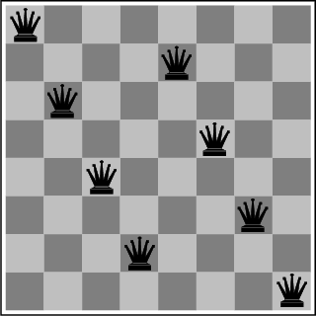
The 8-Queens Problem
State Representation: ? Any position in the game
is the SR for a chess game.
Initial State: ?
The initial arrangement.
(for a chess game)
Operators: One move for each side and pieces move according to constraints.
(for a chess game)
Goal: Place eight queens on a chessboard such that no queen attacks any other!

Slide 14
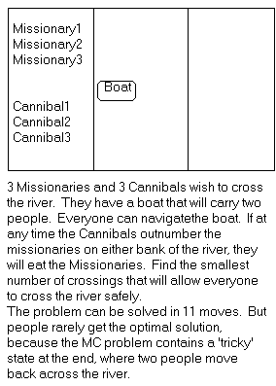
Missionaries and Cannibals
Three missionaries and three cannibals wish to cross the river. They have a small boat that will carry up to two people. Everyone can navigate the boat. If at any time the Cannibals outnumber the Missionaries on either bank of the river, they will eat the Missionaries. Find the smallest number of crossings that will allow everyone to cross the river safely.

Slide 15
Missionaries and Cannibals
Goal: Move all the missionaries and cannibals across the river.
Constraint: Missionaries can never be outnumbered by cannibals on either side of river, or else the missionaries are killed.
State: configuration of missionaries and cannibals and boat on each side of river.
Initial State: 3 missionaries, 3 cannibals and the boat are on the near bank
Operators: Move boat containing some set of occupants across the river (in either direction) to the other side.
Goal: Move all the missionaries and cannibals across the river.
Constraint: Missionaries can never be outnumbered by cannibals on either side of river, or else the missionaries are killed.
State: configuration of missionaries and cannibals and boat on each side of river.
Initial State: 3 missionaries, 3 cannibals and the boat are on the near bank
Operators: Move boat containing some set of occupants across the river (in either direction) to the other side.

Slide 16
Missionaries and Cannibals Solution
Near side Far side
0 Initial setup: MMMCCC B -
1 Two cannibals cross over: MMMC B CC
2 One comes back: MMMCC B C
3 Two cannibals go over again: MMM B CCC
4 One comes back: MMMC B CC
5 Two missionaries cross: MC B MMCC
6 A missionary & cannibal return: MMCC B MC
7 Two missionaries cross again: CC B MMMC
8 A cannibal returns: CCC B MMM
9 Two cannibals cross: C B MMMCC
10 One returns: CC B MMMC
11 And brings over the third: - B MMMCCC

Slide 17
Cryptarithmetic
Find an assignment of digits (0, ..., 9) to letters so that a given arithmetic expression is true. examples: SEND + MORE = MONEY and
    FORTY Solution: 29786
    + TEN 850
    + TEN 850
    ----- -----
    SIXTY 31486
    F=2, O=9, R=7, etc.

Slide 18
Cryptarithmetic
State: mapping from letters to digits
Initial State: empty mapping
Operators: assign a digit to a letter
Goal Test: whether the expression is true given the complete mapping
State: mapping from letters to digits
Initial State: empty mapping
Operators: assign a digit to a letter
Goal Test: whether the expression is true given the complete mapping
Note: In this problem, the solution is NOT a sequence of actions that transforms the initial state into the goal state; rather, the solution is a goal node that includes an assignment of a digit to each letter in the given problem.
Find an assignment of digits to letters so that a given arithmetic expression is true. examples: SEND + MORE = MONEY and
    FORTY Solution: 29786
    + TEN 850
    + TEN 850
    ----- -----
    SIXTY 31486
    F=2, O=9, R=7, etc.

Slide 19
Remove 5 Sticks
Given the following configuration of sticks, remove exactly 5 sticks in such a way that the remaining configuration forms exactly 3 squares.
State: ?
Initial State: ?
Operators: ?
Goal Test: ?

Slide 20
Water Jug Problem
Given a full 5-gallon jug and a full 2-gallon jug, fill the 2-gallon jug with exactly one gallon of water.
State: ?
Initial State: ?
Operators: ?
Goal State: ?
5
2

Slide 21
Water Jug Problem
State = (x,y), where x is the number of gallons of water in the 5-gallon jug and y is # of gallons in the 2-gallon jug
Initial State = (5,2)
Goal State = (*,1), where * means any amount
Operator table
5
Name | Cond. | Transition | Effect
Empty5 | – | (x,y)→(0,y) | Empty 5-gal. jug
Empty2 | – | (x,y)→(x,0) | Empty 2-gal. jug
2to5 | x ≤ 3 | (x,2)→(x+2,0) | Pour 2-gal. into 5-gal.
5to2 | x ≥ 2 | (x,0)→(x-2,2) | Pour 5-gal. into 2-gal.
5to2part | y < 2 | (1,y)→(0,y+1) | Pour partial 5-gal. into 2-gal.
2

Slide 22
Some more real-world problems
Route finding
Touring (traveling salesman)
Logistics
VLSI layout
Robot navigation
Learning

Slide 23
Knowledge representation issues
What’s in a state ?
  Is the color of the boat relevant to solving the Missionaries and Cannibals problem? Is sunspot activity relevant to predicting the stock market? What to represent is a very hard problem that is usually left to the system designer to specify.
What level of abstraction or detail to describe the world.
  Too fine-grained and we’ll “miss the forest for the trees.” Too coarse-grained and we’ll miss critical details for solving the problem.
The number of states depends on the representation and level of abstraction chosen.
  In the Remove-5-Sticks problem, if we represent the individual sticks, then there are 17-choose-5 possible ways of removing 5 sticks.
  On the other hand, if we represent the “squares” defined by 4 sticks, then there are 6 squares initially and we must remove 3 squares, so only 6-choose-3 ways of removing 3 squares.

Slide 24
Formalizing search in a state space
A state space is a graph (V, E) where V is a set of nodes and E is a set of arcs, and each arc is directed from a node to another node
Each node is a data structure that contains a state description plus other information such as the parent of the node, the name of the operator that generated the node from that parent, and other bookkeeping data
Each arc corresponds to an instance of one of the operators. When the operator is applied to the state associated with the arc’s source node, then the resulting state is the state associated with the arc’s destination node

Slide 25
Formalizing search II
Each arc has a fixed, positive cost associated with it corresponding to the cost of the operator.
Each node has a set of successor nodes corresponding to all of the legal operators that can be applied at the source node’s state.
  The process of expanding a node means to generate all of the successor nodes and add them and their associated arcs to the state-space graph
One or more nodes are designated as start nodes.
A goal test predicate is applied to a state to determine if its associated node is a goal node.

Slide 26
Water jug state space
5, 2
5, 1
5, 0
Empty5
4, 2
4, 1
4, 0
Empty2
3, 2
3, 1
3, 0
2to5
2, 2
2, 1
2, 0
5to2
1, 2
1, 1
1, 0
5to2part
0, 2
0, 1
0, 0

Slide 27
Water jug solution
5, 2
5, 1
5, 0
4, 2
4, 1
4, 0
3, 2
3, 1
3, 0
2, 2
2, 1
2, 0
1, 2
1, 1
1, 0
0, 2
0, 1
0, 0

Slide 28
Formalizing search III
A solution is a sequence of operators that is associated with a path in a state space from a start node to a goal node.
The cost of a solution is the sum of the arc costs on the solution path.
  If all arcs have the same (unit) cost, then the solution cost is just the length of the solution (number of steps / state transitions)

Slide 29
Formalizing search IV
State-space search is the process of searching through a state space for a solution by making explicit a sufficient portion of an implicit state-space graph to find a goal node.
  For large state spaces, it isn’t practical to represent the whole space.
  Initially V={S}, where S is the start node; when S is expanded, its successors are generated and those nodes are added to V and the associated arcs are added to E. This process continues until a goal node is found.
Each node implicitly or explicitly represents a partial solution path (and cost of the partial solution path) from the start node to the given node.
  In general, from this node there are many possible paths (and therefore solutions) that have this partial path as a prefix.

Slide 30
State-space search algorithm
function general-search (problem, QUEUEING-FUNCTION)
;; problem describes the start state, operators, goal test, and operator costs
;; queueing-function is a comparator function that ranks two states
;; general-search returns either a goal node or failure
nodes = MAKE-QUEUE(MAKE-NODE(problem.INITIAL-STATE))
loop
if EMPTY(nodes) then return "failure"
node = REMOVE-FRONT(nodes)
if problem.GOAL-TEST(node.STATE) succeeds
then return node
nodes = QUEUEING-FUNCTION(nodes, EXPAND(node,
problem.OPERATORS))
end
;; Note: The goal test is NOT done when nodes are generated
;; Note: This algorithm does not detect loops

Slide 31
Key procedures to be defined
EXPAND
  Generate all successor nodes of a given node
GOAL-TEST
  Test if state satisfies all goal conditions
QUEUEING-FUNCTION
  Used to maintain a ranked list of nodes that are candidates for expansion

Slide 32
Bookkeeping
Typical node data structure includes:
  State at this node
  Parent node
  Operator applied to get to this node
  Depth of this node (number of operator applications since initial state)
  Cost of the path (sum of each operator application so far)

Slide 33
Some issues
Search process constructs a search tree, where
  root is the initial state and
  leaf nodes are nodes
    not yet expanded (i.e., they are in the list “nodes”) or
    having no successors (i.e., they’re “deadends” because no operators were applicable and yet they are not goals)
Search tree may be infinite because of loops even if state space is small
Return a path or a node depending on problem.
  E.g., in cryptarithmetic return a node; in 8-puzzle return a path
Changing definition of the QUEUEING-FUNCTION leads to different search strategies

Slide 34
Evaluating Search Strategies
Completeness
  Guarantees finding a solution whenever one exists
Time complexity
  How long (worst or average case) does it take to find a solution? Usually measured in terms of the number of nodes expanded
Space complexity
  How much space is used by the algorithm? Usually measured in terms of the maximum size of the “nodes” list during the search
Optimality/Admissibility
  If a solution is found, is it guaranteed to be an optimal one? That is, is it the one with minimum cost?

Slide 35
Uninformed vs. informed search
Uninformed search strategies
  Also known as “blind search,” uninformed search strategies use no information about the likely “direction” of the goal node(s)
  Uninformed search methods: Breadth-first, depth-first, depth-limited, uniform-cost, depth-first iterative deepening, bidirectional
Informed search strategies
  Also known as “heuristic search,” informed search strategies use information about the domain to (try to) (usually) head in the general direction of the goal node(s)
  Informed search methods: Hill climbing, best-first, greedy search, beam search, A, A*

Slide 36
Example for illustrating uninformed search strategies
S
3
8
1
A
B
C
3
15
7
20
5
D
E
G

Slide 37
Uninformed Search Methods

Slide 38
Breadth-First
Enqueue nodes on nodes in FIFO (first-in, first-out) order.
Complete
Optimal (i.e., admissible) if all operators have the same cost. Otherwise, not optimal but finds solution with shortest path length.
Exponential time and space complexity, O(b^{d}), where d is the depth of the solution and b is the branching factor (i.e., number of children) at each node
Will take a long time to find solutions with a large number of steps because must look at all shorter length possibilities first
  A complete search tree of depth d where each non-leaf node has b children, has a total of 1 + b + b² + ... + b^{d} = (b^{(d+1)} - 1)/(b-1) nodes
  For a complete search tree of depth 12, where every node at depths 0, ..., 11 has 10 children and every node at depth 12 has 0 children, there are 1 + 10 + 100 + 1000 + ... + 10¹² = (10¹³ - 1)/9 = O(10¹²) nodes in the complete search tree. If BFS expands 1000 nodes/sec and each node uses 100 bytes of storage, then BFS will take 35 years to run in the worst case, and it will use 111 terabytes of memory!

Slide 39
Depth-First (DFS)
Enqueue nodes on nodes in LIFO (last-in, first-out) order. That is, nodes used as a stack data structure to order nodes.
May not terminate without a “depth bound,” i.e., cutting off search below a fixed depth D ( “depth-limited search”)
Not complete (with or without cycle detection, and with or without a cutoff depth)
Exponential time, O(b^{d}), but only linear space, O(bd)
Can find long solutions quickly if lucky (and short solutions slowly if unlucky!)
When search hits a dead-end, can only back up one level at a time even if the “problem” occurs because of a bad operator choice near the top of the tree. Hence, only does “chronological backtracking”

Slide 40
Uniform-Cost (UCS)
Enqueue nodes by path cost. That is, let g(n) = cost of the path from the start node to the current node n. Sort nodes by increasing value of g.
Called “Dijkstra’s Algorithm” in the algorithms literature and similar to “Branch and Bound Algorithm” in operations research literature
Complete (*)
Optimal/Admissible (*)
Admissibility depends on the goal test being applied when a node is removed from the nodes list, not when its parent node is expanded and the node is first generated
Exponential time and space complexity, O(b^{d})

Slide 41
Depth-First Iterative Deepening (DFID)
First do DFS to depth 0 (i.e., treat start node as having no successors), then, if no solution found, do DFS to depth 1, etc.
    until solution found do
    DFS with depth cutoff c
    c = c+1
Complete
Optimal/Admissible if all operators have the same cost. Otherwise, not optimal but guarantees finding solution of shortest length (like BFS).
Time complexity seems worse than BFS or DFS because nodes near the top of the search tree are generated multiple times, but because almost all of the nodes are near the bottom of a tree, the worst case time complexity is still exponential, O(b^{d}).

Slide 42
Depth-First Iterative Deepening
If branching factor is b and solution is at depth d, then nodes at depth d are generated once, nodes at depth d-1 are generated twice, etc.
  IDS : (d) b + (d-1) b² + … + (2) b^{(d-1)} + b^{d} = O(b^{d}).
  If b=4, then worst case is 1.78 * 4^{d}, i.e., 78% more nodes searched than exist at depth d (in the worst case).
However, let’s compare this to the time spent on BFS:
  BFS : b + b² + … + b^{d} + (b^{(d+1)} – b) = O(b^{d}).
  Same time complexity of O(b^{d}), but BFS expands some nodes at depth d+1, which can make a HUGE difference:
    With b = 10, d = 5,
    BFS: 10 + 100 + 1,000 + 10,000 + 100,000 + 999,990 = 1,111,100
    IDS: 50 + 400 + 3,000 + 20,000 + 100,000 = 123,450
IDS can actually be quicker in-practice than BFS, even though it regenerates early states.

Slide 43
Depth-First Iterative Deepening
Exponential time complexity, O(b^{d}), like BFS
Linear space complexity, O(bd), like DFS
Has advantage of BFS (i.e., completeness) and also advantages of DFS (i.e., limited space and finds longer paths more quickly)
Generally preferred for large state spaces where solution depth is unknown

Slide 44
Uninformed Search Results

Slide 45
Breadth-First Search
Expanded node Nodes list
{ S⁰ }
S⁰ { A³ B¹ C⁸ }
A³ { B¹ C⁸ D⁶ E¹⁰ G¹⁸ }
B¹ { C⁸ D⁶ E¹⁰ G¹⁸ G²¹ }
C⁸ { D⁶ E¹⁰ G¹⁸ G²¹ G¹³ }
D⁶ { E¹⁰ G¹⁸ G²¹ G¹³ }
E¹⁰ { G¹⁸ G²¹ G¹³ }
G¹⁸ { G²¹ G¹³ }
Solution path found is S A G , cost 18
Number of nodes expanded (including goal node) = 7

Slide 46
Depth-First Search
Expanded node Nodes list
{ S⁰ }
S⁰ { A³ B¹ C⁸ }
A³ { D⁶ E¹⁰ G¹⁸ B¹ C⁸ }
D⁶ { E¹⁰ G¹⁸ B¹ C⁸ }
E¹⁰ { G¹⁸ B¹ C⁸ }
G¹⁸ { B¹ C⁸ }
Solution path found is S A G, cost 18
Number of nodes expanded (including goal node) = 5

Slide 47
Uniform-Cost Search
Expanded node Nodes list
{ S⁰ }
S⁰ { B¹ A³ C⁸ }
B¹ { A³ C⁸ G²¹ }
A³ { D⁶ C⁸ E¹⁰ G¹⁸ G²¹ }
D⁶ { C⁸ E¹⁰ G¹⁸ G¹ }
C⁸ { E¹⁰ G¹³ G¹⁸ G²¹ }
E¹⁰ { G¹³ G¹⁸ G²¹ }
G¹³ { G¹⁸ G²¹ }
Solution path found is S B G, cost 13
Number of nodes expanded (including goal node) = 7

Slide 48
How they perform
Breadth-First Search:
  Expanded nodes: S A B C D E G
  Solution found: S A G (cost 18)
Depth-First Search:
  Expanded nodes: S A D E G
  Solution found: S A G (cost 18)
Uniform-Cost Search:
  Expanded nodes: S A D B C E G
  Solution found: S B G (cost 13)
  This is the only uninformed search that worries about costs.
Iterative-Deepening Search:
  nodes expanded: S S A B C S A D E G
  Solution found: S A G (cost 18)

Slide 49
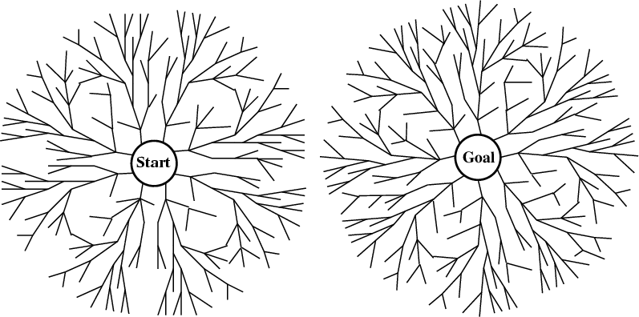
Bi-directional search
Alternate searching from the start state toward the goal and from the goal state toward the start.
Stop when the frontiers intersect.
Works well only when there are unique start and goal states.
Requires the ability to generate “predecessor” states.
Can (sometimes) lead to finding a solution more quickly.
Time complexity: O(b^{d/2}). Space complexity: O(b^{d/2}).

Slide 50
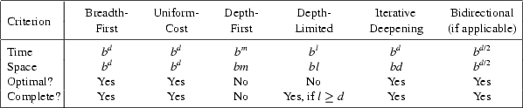
Comparing Search Strategies
b – branching factor d – depth of optimal solution
m – maximum depth l – depth limit

Slide 51
Avoiding Repeated States
In increasing order of effectiveness in reducing size of state space and with increasing computational costs:
  1. Do not return to the state you just came from.
  2. Do not create paths with cycles in them.
  3. Do not generate any state that was ever created before.
Net effect depends on frequency of “loops” in state space.

Slide 52
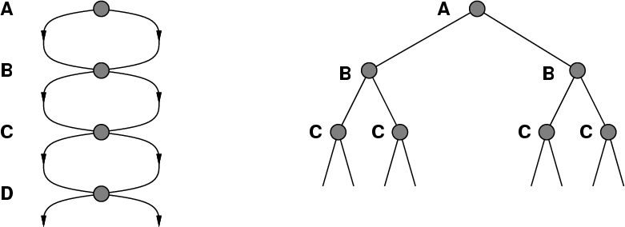
A State Space that Generates an
Exponentially Growing Search Space

Slide 53
Graph Search
function graph-search (problem, QUEUEING-FUNCTION)
;; problem describes the start state, operators, goal test, and operator costs
;; queueing-function is a comparator function that ranks two states
;; graph-search returns either a goal node or failure
nodes = MAKE-QUEUE(MAKE-NODE(problem.INITIAL-STATE))
closed = {}
loop
if EMPTY(nodes) then return "failure"
node = REMOVE-FRONT(nodes)
if problem.GOAL-TEST(node.STATE) succeeds
then return node.SOLUTION
if node.STATE is not in closed
then ADD(node, closed)
nodes = QUEUEING-FUNCTION(nodes,
EXPAND(node, problem.OPERATORS))
end
;; Note: The goal test is NOT done when nodes are generated
;; Note: closed should be implemented as a hash table for efficiency

Slide 54
Graph Search Strategies
Breadth-first search and uniform-cost search are optimal graph search strategies.
Iterative deepening search and depth-first search can follow a non-optimal path to the goal.
Iterative deepening search can be used with modification:
  It must check whether a new path to a node is better than the original one
  If so, IDS must revise the depths and path costs of the node’s descendants.

Slide 55
Holy Grail Search
Expanded node Nodes list
{ S⁰ }
S⁰ {C⁸ A³ B¹ }
C⁸ { G¹³ A³ B¹ }
G¹³ { A³ B¹ }
Solution path found is S C G, cost 13 (optimal)
Number of nodes expanded (including goal node) = 3
(as few as possible!)
If only we knew where we were headed…

